Slide 1









SMART WASTE DUSTBIN SYSTEM USING ARDUINO
Sanket Jadhav
Omprakash Singh Parihar
Vaishnavi Yadav

Slide 2

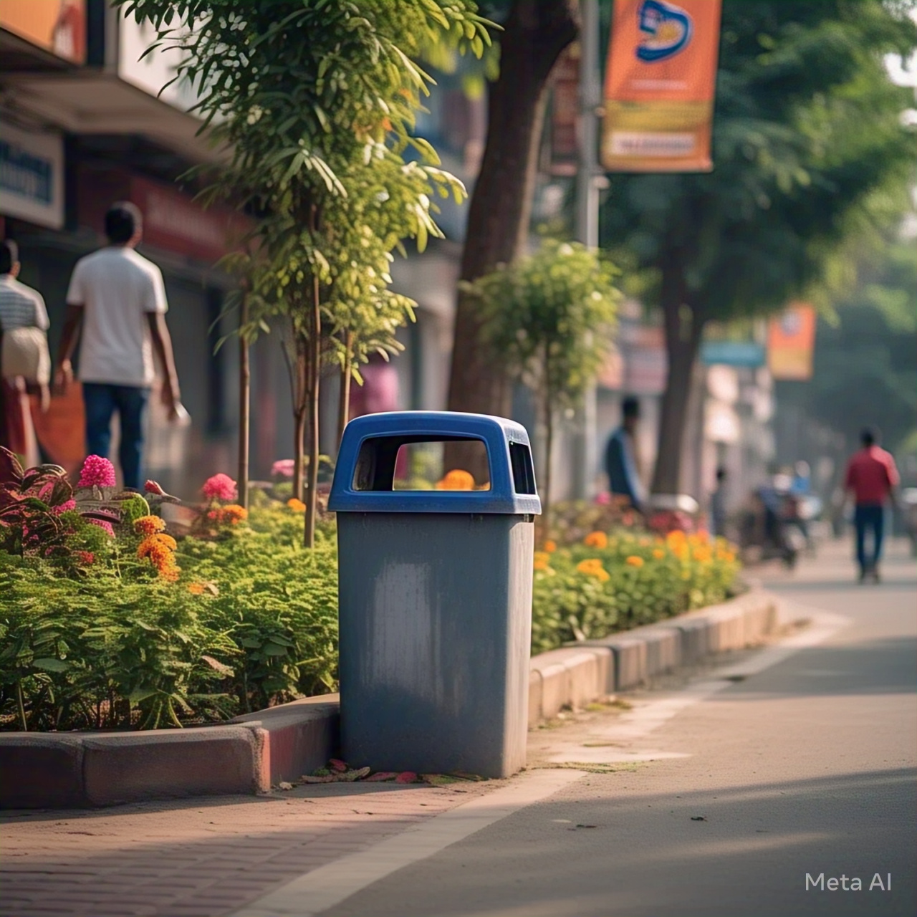
OBJECTIVE
➤To ensure the protection of the environment through effective waste management
➤To protect the health and wellbeing of people by providing an affordable collection service
➤ Ensure separation at source in all metropolitan and local municipalities
➤Increase thermal treatment and conversion of waste to energy
➤Preventing pollution and ecological degradation
➤It uses green energy

Slide 3

INTRODUCTION
A normal dustbin that supports technology equipments. which consist of sensor technology, GPS technology and other more.
Smart dustbin constantly checks current stock level.
When the maximum stock level is reached the smart dustbin will notify the department to collect the waste.

Slide 4
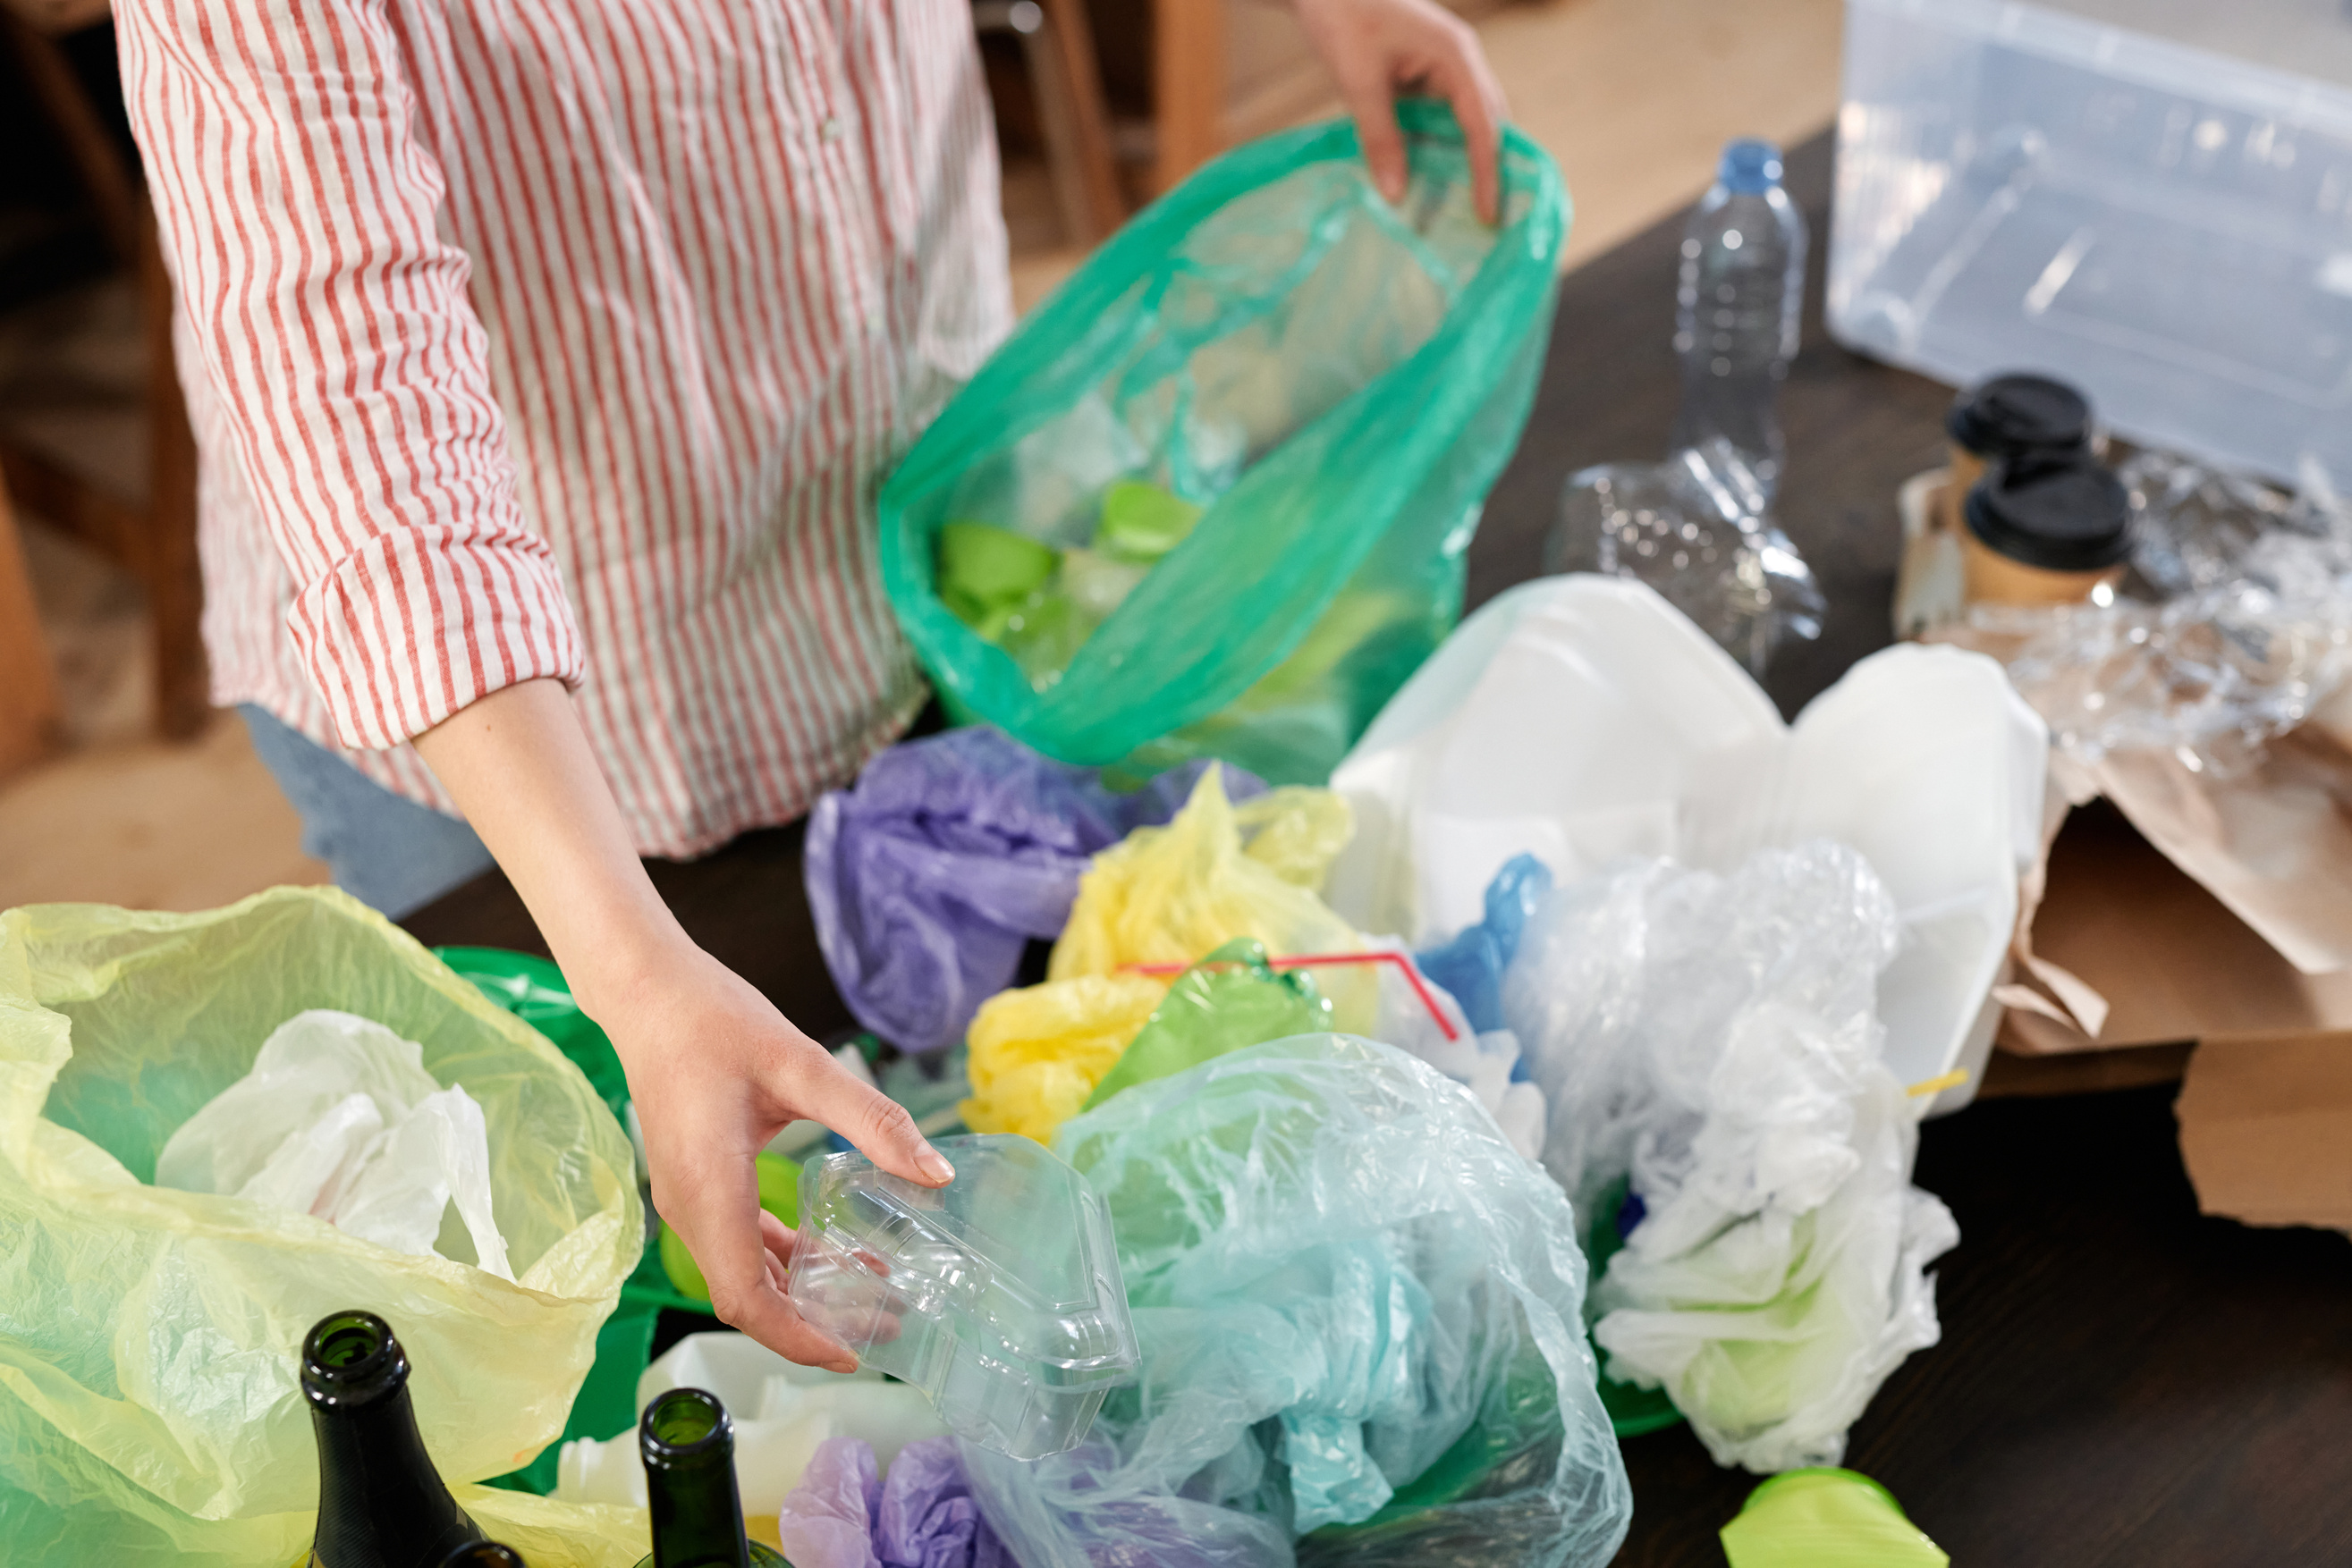
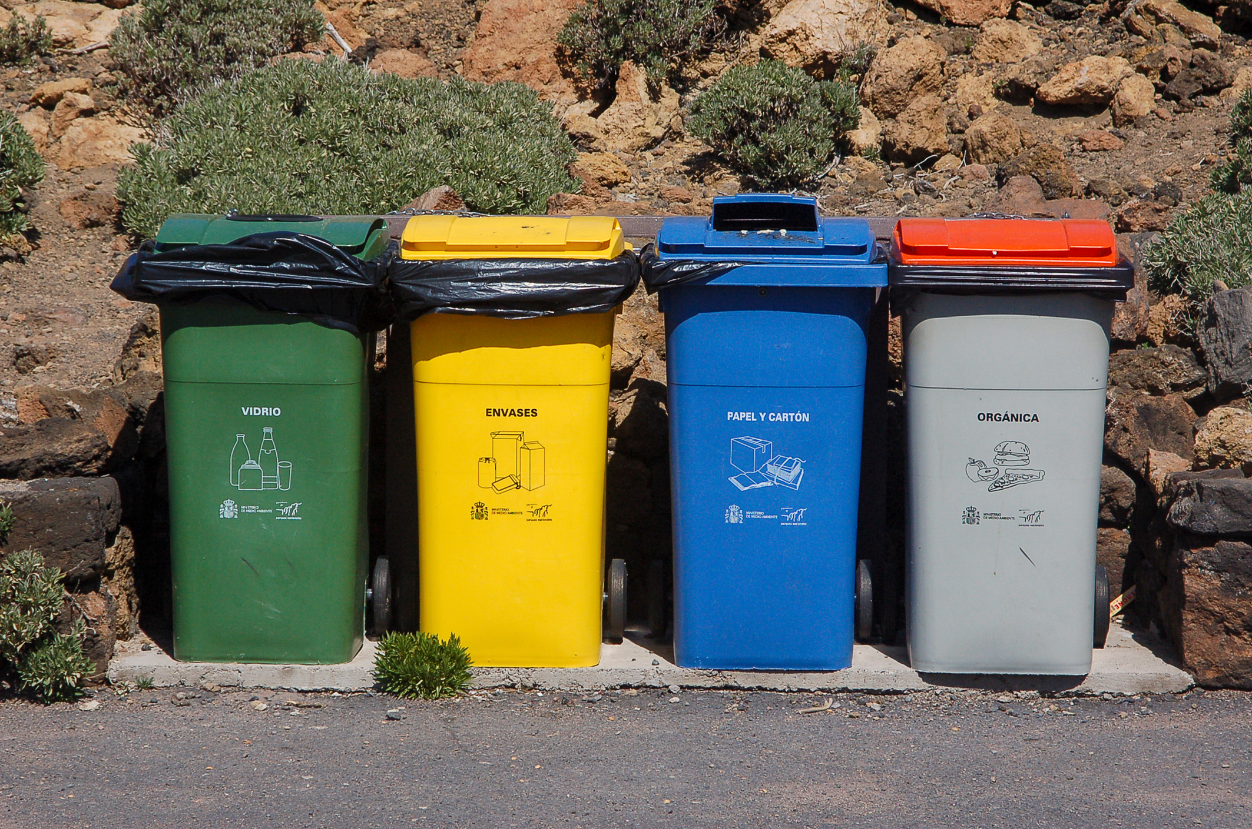
HOW IT WORKS
► Check the fill level of dustbins whether the dustbins are full or not
► It will inform the status of each and every dustbin so that concerned authority can send the garbage collection vehicle.
► The level of waste in the dustbins is detected with the help of Ultrasonic sensor.
► Force sensor is used to measure the weight of the dustbin.
► When the measured value of sensors stand out a certain threshold value then red led becomes ON.
► Android device will detects, in which area dustbin is located and status of that.

Slide 5
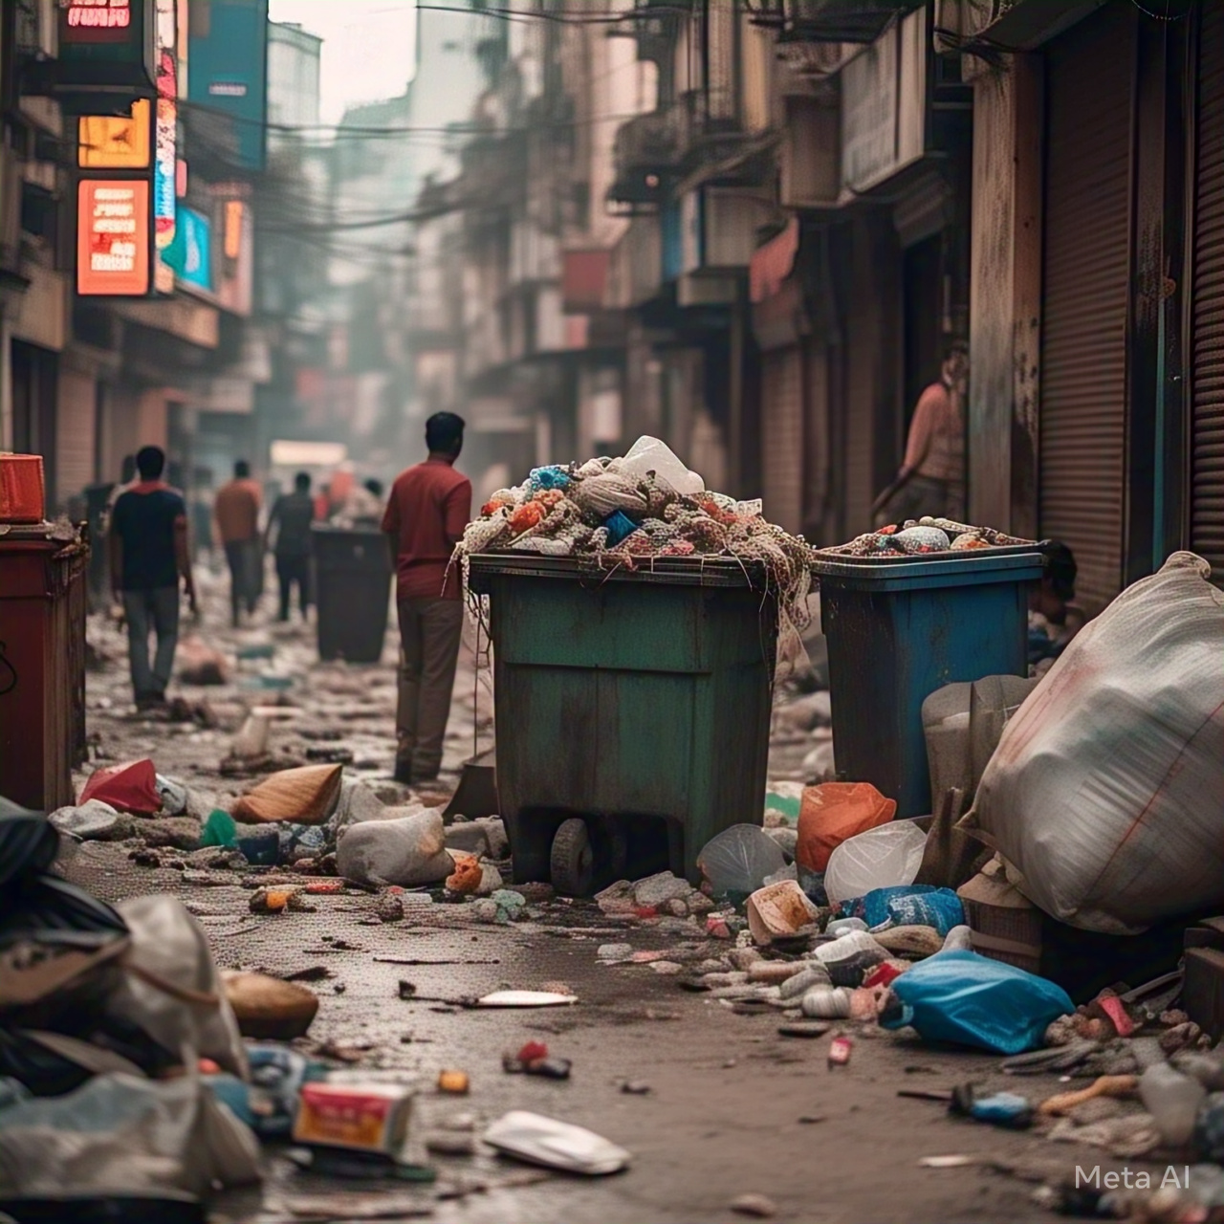
Waste Generation In India
Current scenario
►India: 0.14 million tonnes garbage generated daily
► World: 4.7 million tonnes garbage generated daily
►6 million tonnes is expected to be generated by2025

Slide 6
DRAWBACKS OF CURRENT SYSTEM
Garbage overflow
Unhealthy and untidy surroundings
Cannot cope up with the amount of garbage
PROPOSED SYSTEM
It continuously monitors the level of garbage in the bin
Informs authorities when it needed to be cleared
COMPONENTS
COMPONENTS
1. Arduino UNO
2. HC-SRO4 Ultrasonic Sensor Module
3. TowerPro SG90 Servo Motor
4. A small dustbin with hinged lid
5. 9V Power Supply
6. Connecting Wires
7. GSM module
8. PIR motion sensor

Slide 7
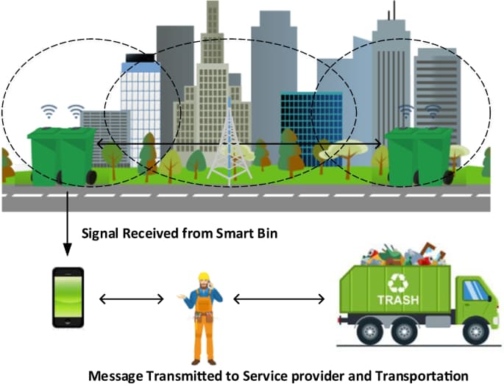
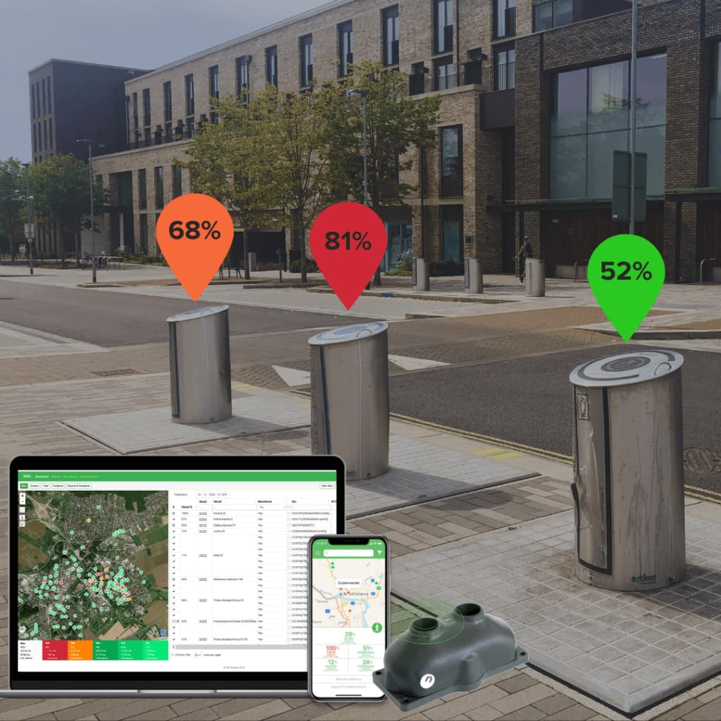
REAL TIME ANALYSIS

Slide 8
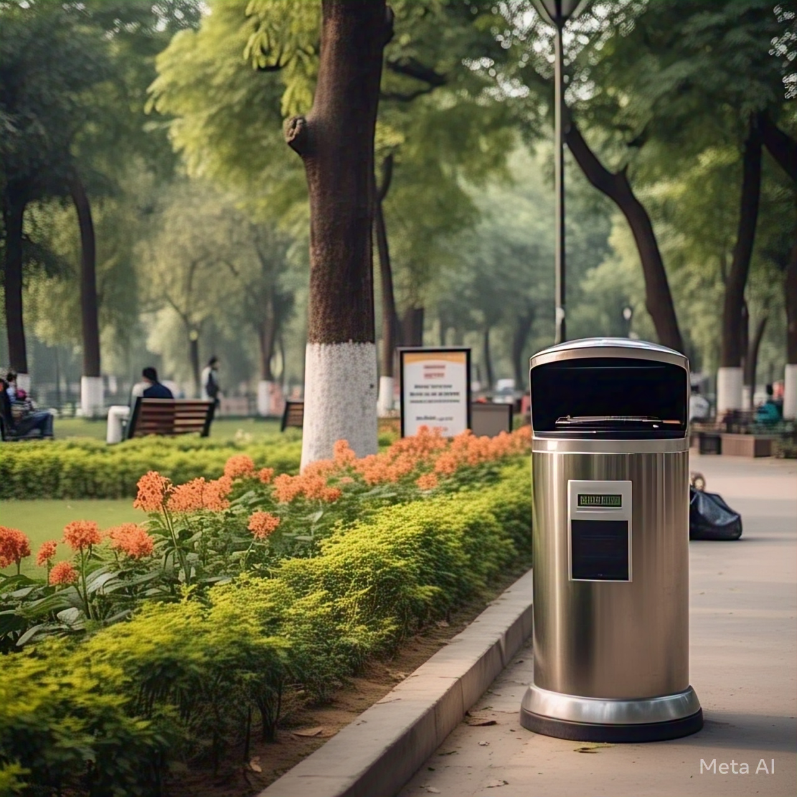
CONCLUSION
► The system help to monitoring of domestic wastage can be at proper time to avoid damage to the public health. A web server is also been set up through which the authorities also get information about the bins in their area. It uses sensors for sensing information of Bins and sending to workstation, which is situated at municipal office for finding shortest path.
► This project came in comfortable which a worthy clarification for maintaining green environment. The proposed system is an attempt to improve current waste collection system in India for the "Clean India Mission".

Slide 9


THANK YOU VERY MUCH !

